Slide 1
Muling Pagbaha:
A Data Driven Intervention
A Case on Government & Public Policy
Group 1
Leduna, Maclang, Malaluan, Pausal, Ullegue

Slide 3


Slide 4
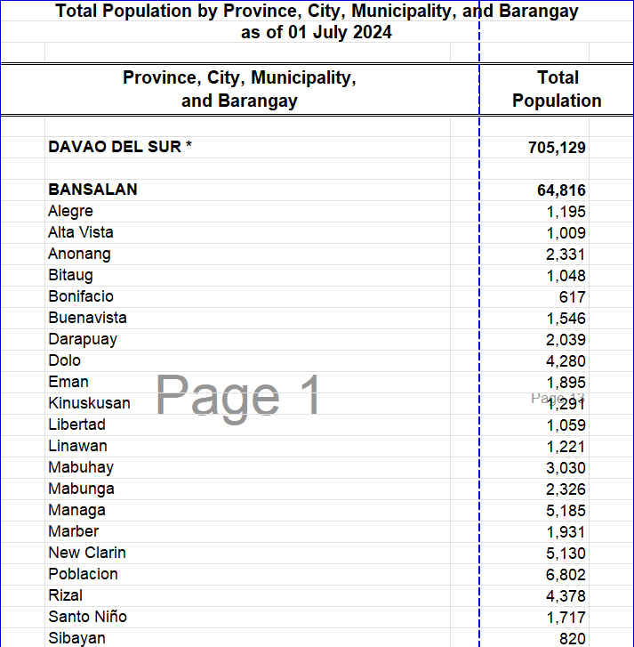
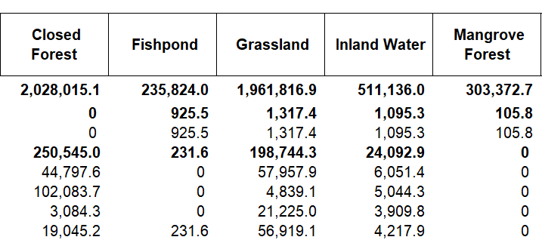
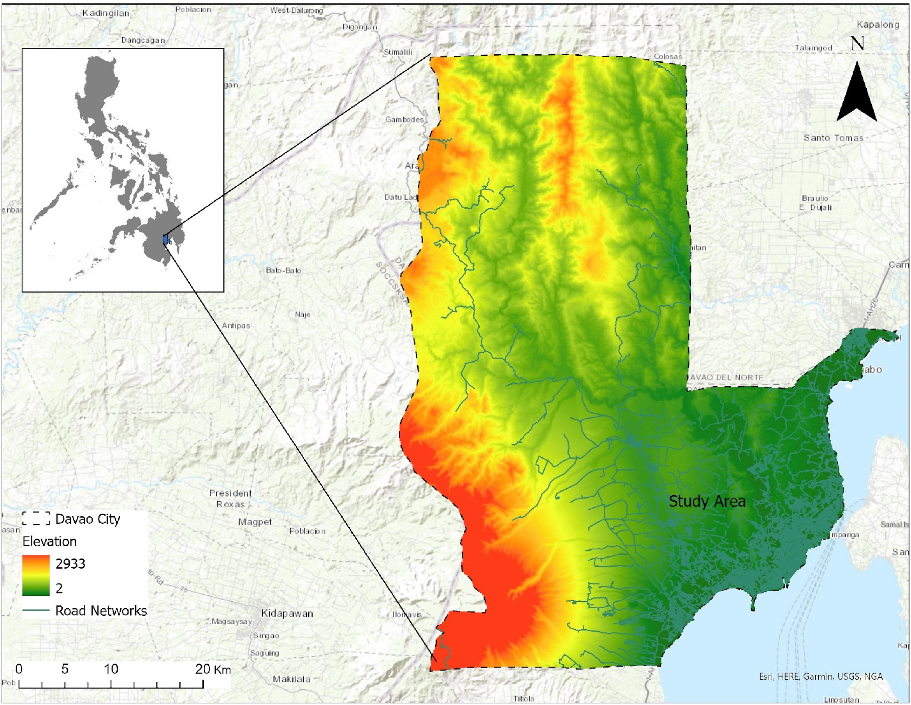

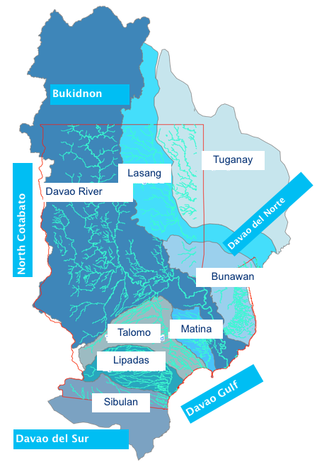
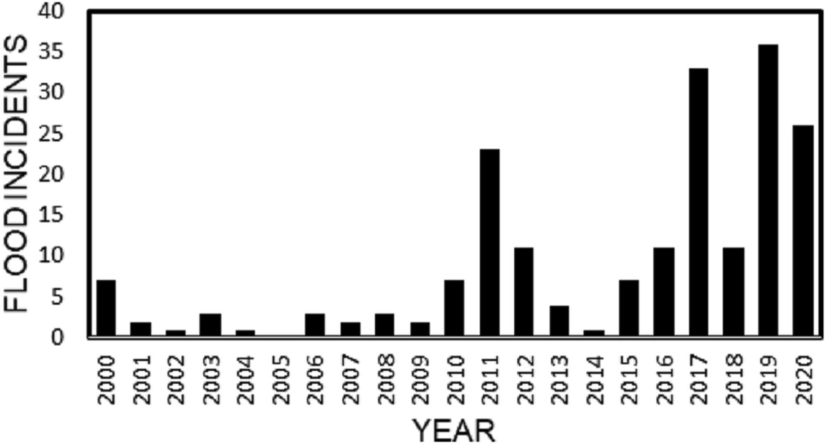
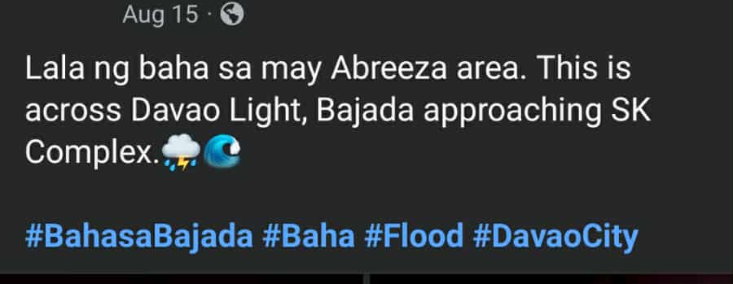

Slide 5
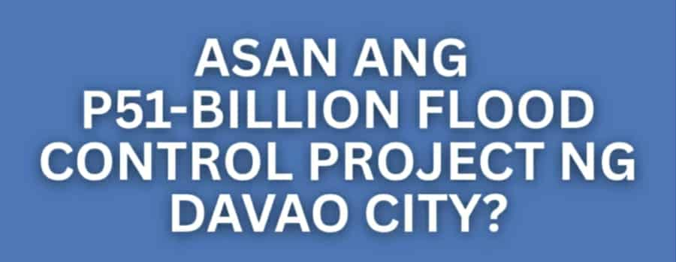

Slide 7
Geographic

Slide 8
Geographic
Information

Slide 9
Geographic
Information
System

Slide 10
Data Collection

Slide 11
Data Collection
River Networks
Land Elevation
Population
Public Sentiment

Slide 12
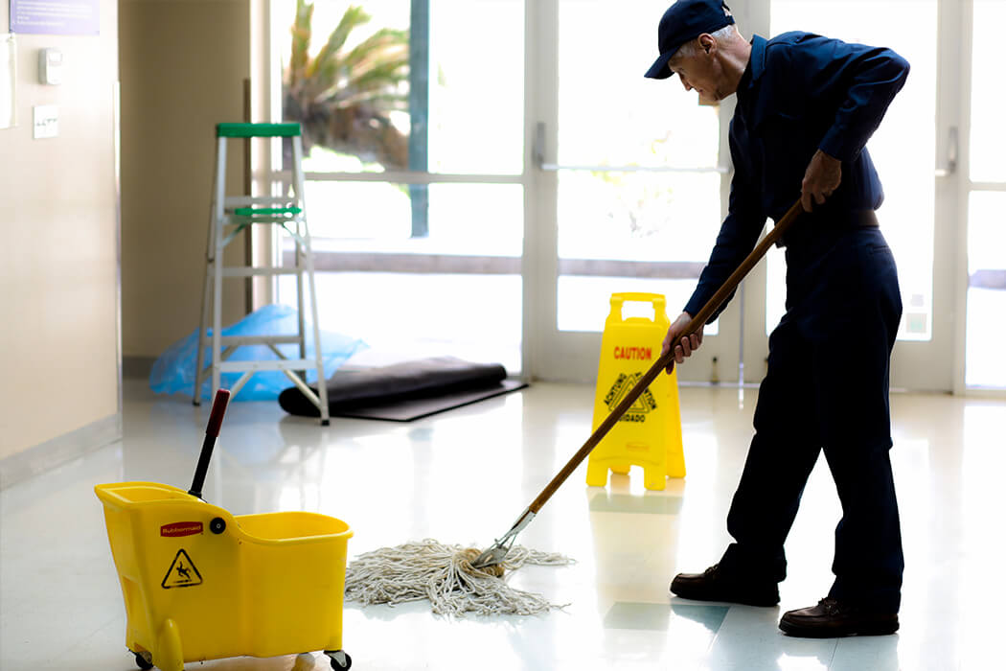
Data Collection
Kadaghan ani oyh.
River Networks
Population
Public Sentiment
Land Elevation
Cleaning Data

Slide 13
Data Collection
Data Preparation
Data
Kadaghan ani oyh.
Data
Data
Data
Data
Cleaning Data

Slide 14
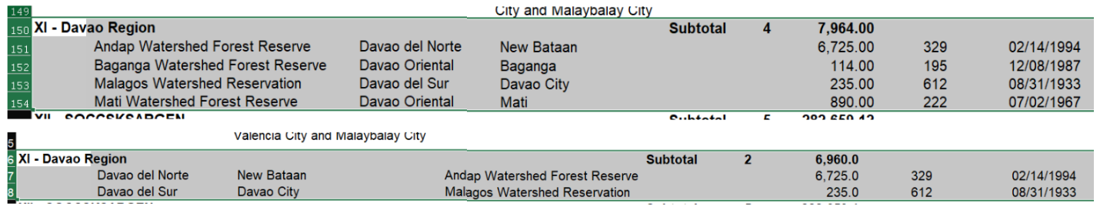

Data Preparation
Data Inconsistencies
Null Values
Taken from:
https://openstat.psa.gov.ph/ https://psa.gov.ph/content/cpes-component-1-environmental-conditions-and-quality-2008-2017
Cleaning Data

Slide 15
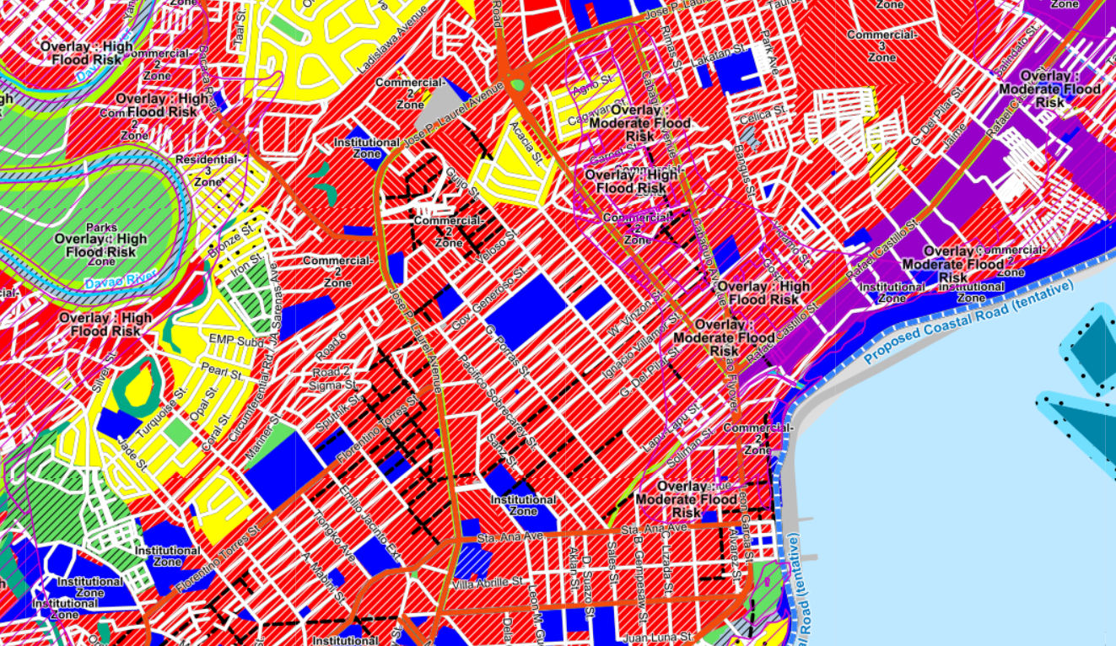
Data Visualization
Taken from:
http://map.davaocity.gov.ph/zoning/
Creating a GIS

Slide 16
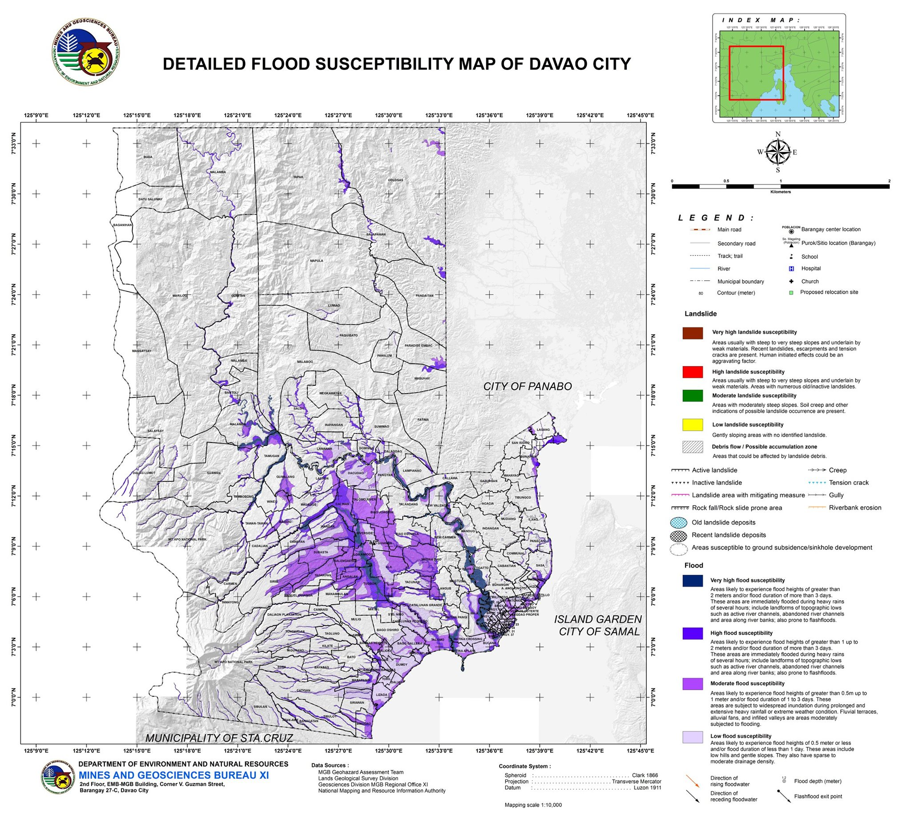
Data Visualization
Creating a GIS
Taken from:
https://www.facebook.com/DavaoDRRMO/posts/attention-to-all-dabawenyos-different-hazard-maps-of-davao-city-for-referenceflo/2376223199127840/

Slide 17
Data Visualization
Flood Incidents in Davao
Taken from:
https://doi.org/10.1016/j.tcrr.2021.06.003

Slide 18
Insights & Actions

Slide 19
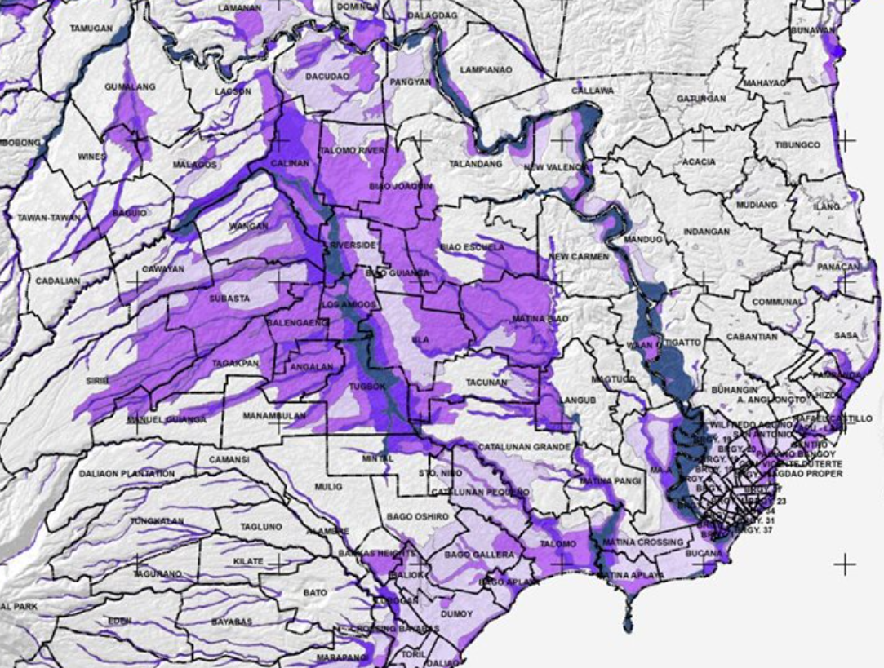
Insights & Actions
Flood-prone areas are found near
rivers & coasts.

Slide 20
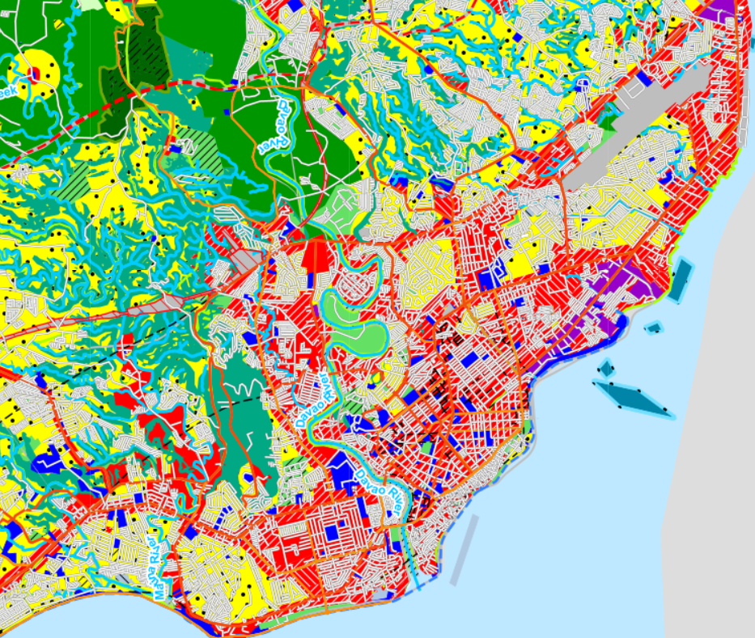
Insights & Actions
Urbanization leads to loss of wetlands and poor drainage

Slide 21
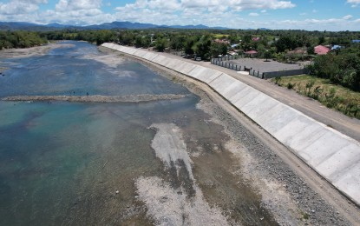
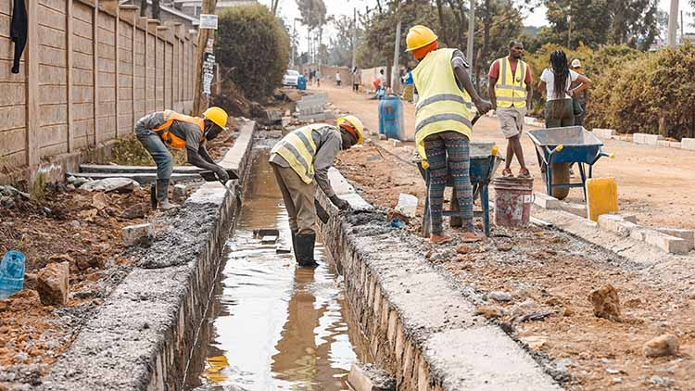
Insights & Actions
Dikes
Better Drainage Systems
Utilizing Flood-Mitigation tools
Flood-prone areas
focused for mitigation

Slide 22
Insights & Actions
Flood-prone areas
focused for mitigation
A blueprint for a safer Davao

Slide 23
Thank You!

